Slide 1
Spiner Octogon Arena
Guillaume Jeannin

Slide 2
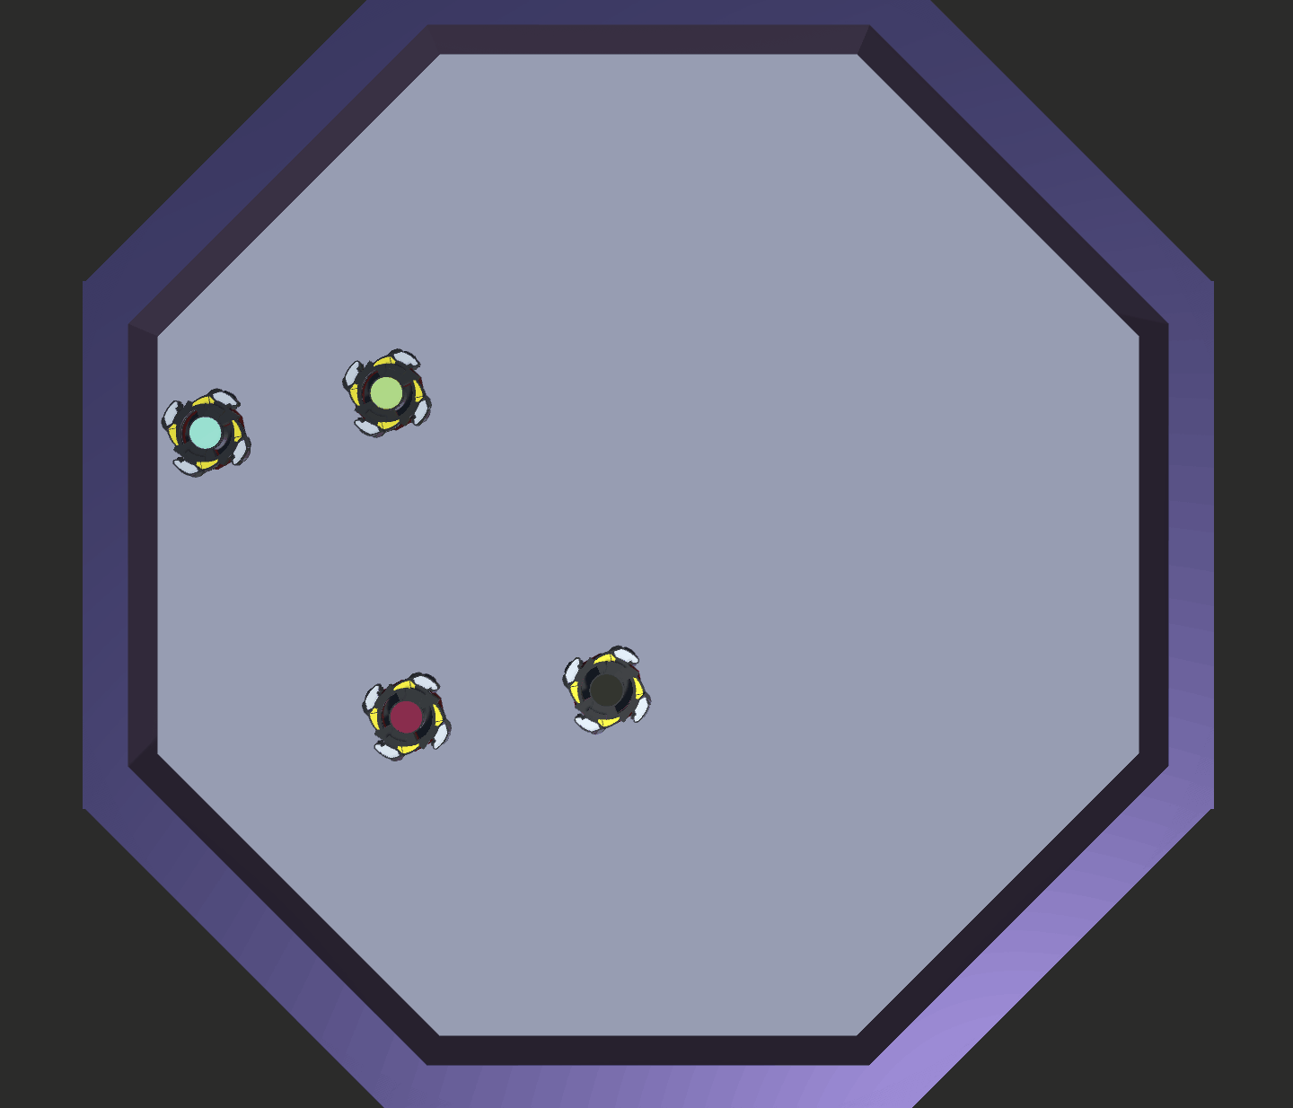
Spiners that play Bumper Car in an Octogon

Slide 3
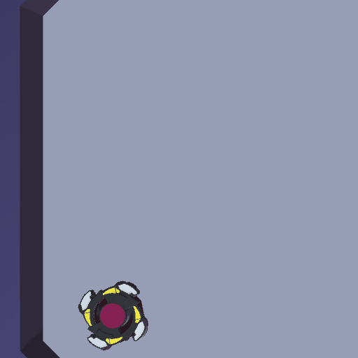
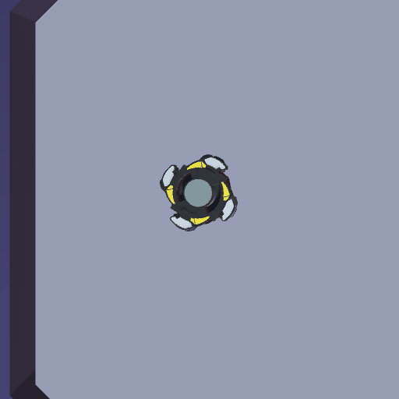
Accelerate gradually
Bump others

Slide 4
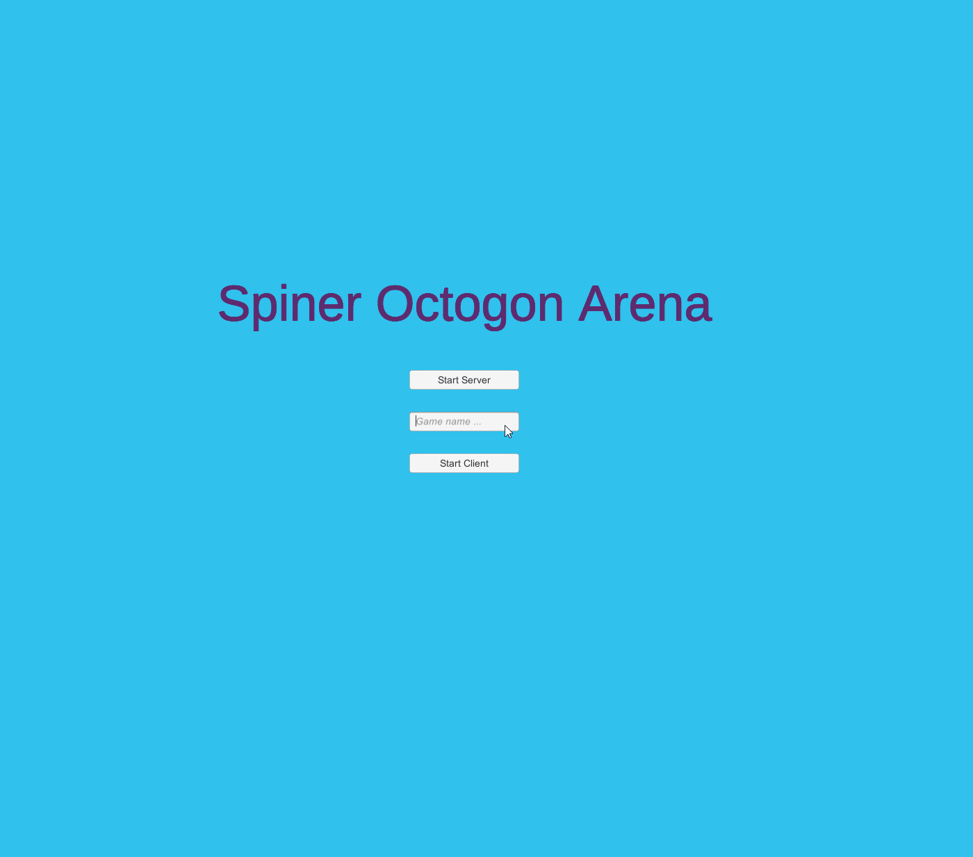

Create a session
Join a session

Slide 5

Made with
Good for Authoritative games
Uses UDP

Slide 6
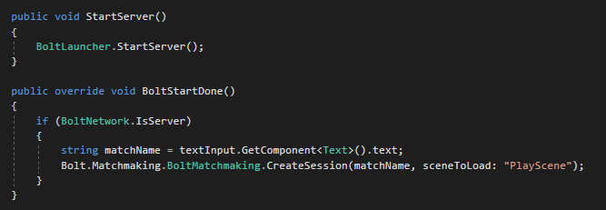
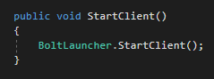
Create servers and clients with bolt methods

Slide 7
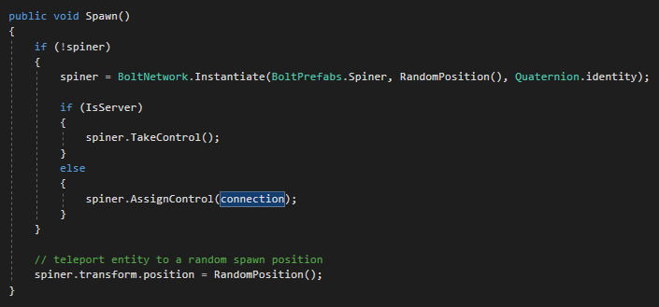
Join a session
Spawn a Spiner

Slide 8
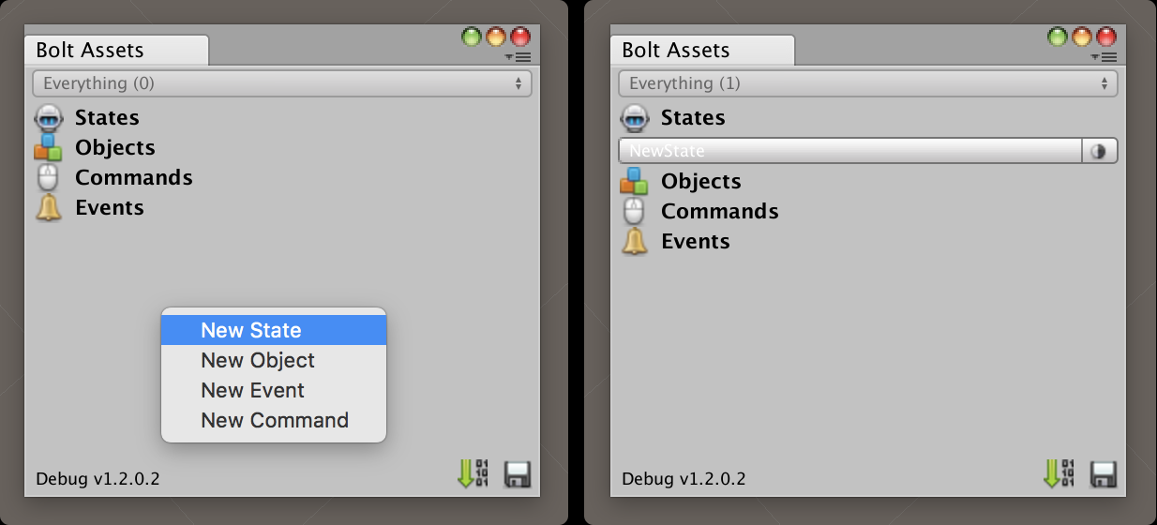
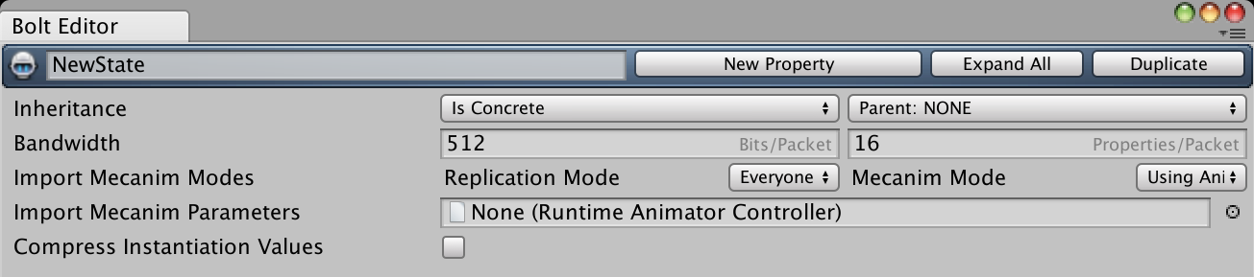
Control your Spiner with states
Sync properties

Slide 9
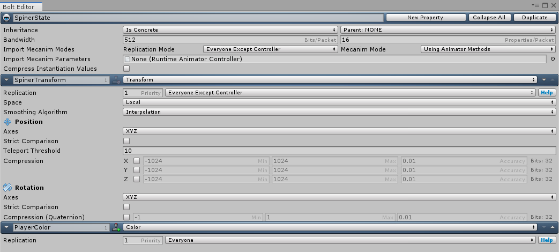
Latency compensation

Slide 10
Client Prediction with server authority Commands
Server
Actual state of the game
Input
Client
Prediction
Correction

Slide 11
Possible improvements
Animations
Better disconnections
More game rules

Slide 12
Thanks !
Guillaume Jeannin

